Slide 1
Content
Analysis
Jour 389R/689R | Fall 2024

Slide 2




Content Analysis
MAKING DATA
QUANTIFYING TEXT
ARTICLES TO DATA
GAIN INSIGHTS
"Content analysis is a research method that provides a systematic and objective means to make valid inferences from verbal, visual or written data in order to describe and quantify specific phenomena."
Downe‐Wamboldt, B. (1992). Content analysis: Method, applications, and issues. Health Care for Women International, 13(3), 313–321.

Slide 3
Content Analysis
MAKING DATA
QUANTIFYING TEXT
ARTICLES TO DATA
GAIN INSIGHTS
TOOLS TO UNCOVER HIDDEN MEANINGS, TRENDS, EVALUATE MEDIA EFFECTS, AND INFORMING DECISION-MAKING.

Slide 4
Content analysis: News Narratives
Plot lines allow media audiences to understand how journalists interpret, or make sense of, particular issues.
Help understand how individuals, including journalists, make sense of the world, and understand the time and context of these decisions
Kenneth Burke, The Philosophy of Literary Form (New York: Random House, 1957)

Slide 5
Goals of Content Analysis
Reveal focus of individual, group, or societal attention; reflect cultural patterns and beliefs; describe themes, trends, and goals in news or communication content; describe attributes of the sender of news or communication and the attitudinal or behavioral responses of the audience or recipients.
Downe-Wamboldt, 1992

Slide 6
Milestone in Content Analysis
Aristotle’s Rhetoric
Tripartite Analysis:
Speaker, Audience and Speech “put message and form at the center of an argument."
Typologies and taxonomies for literature analysis
Notes:
Used at large scale to analyze Nazi propaganda

Slide 7
Enlightenment
Stanford Encyclopedia of Philosophy
http://plato.stanford.edu/entries/enlightenment/
A theoretical background

Slide 8


Enlightenment
“For Kant, Enlightenment was mankind's final coming of age, the emancipation of the human consciousness from an immature state of ignorance”
Rise of the public sphere in Europe

Slide 9


Rise of empiricism
--Newton's method begins with the observed phenomena of nature
–Leibniz: The universe is rationally intelligible
–Journalistic objectivity flows from this mindset

Slide 10


Enlightenment
Reason
“The faith, so important for the Enlightenment, that the universe is fully intelligible to us through the exercise of our natural powers of reason.”

Slide 11
Versatility of content analysis:
Applicable across various disciplines like sociology, media studies, marketing, etc.

Slide 12

Kimberly Neuendorf,
Cleveland State University
Content Analysis: A systematic, objective, quantifiable analysis of message characteristics
Notes:
https://facultyprofile.csuohio.edu/csufacultyprofile/detail.cfm?FacultyID=K_NEUENDORF

Slide 13
Kimberly Neuendorf
Content analysis is a summarizing quantitative analysis of messages that relies on the scientific method (attention to objectivity, intersubjectivity, a priori design, reliability, validity, generalizability, replicability, and hypothesis testing) and is not limited to the types of variables that may be measured
Notes:
https://facultyprofile.csuohio.edu/csufacultyprofile/detail.cfm?FacultyID=K_NEUENDORF

Slide 14

Steps
in the Process

Slide 15
Steps
Selecting unit of analysis
Creating and defining categories
Pretesting the category definitions and rules
Assessing reliability and validity
Revising coding rules if necessary
Pretesting the revised categories
Coding all of the data
Reassessing reliability and validity

Slide 16
"Content analysis is more than a counting game; it is concerned with meanings, intentions, consequences and context."
Downe‐Wamboldt, B. (1992). Content analysis: Method, applications, and issues. Health Care for Women International, 13(3), 313–321.

Slide 17
Content Analysis
Common Tasks
Counting Sources
Measuring Specific Narratives
Establishing Categories

Slide 18
Unit of Analysis
Words, sentences, paragraphs, whole texts

Slide 19
Typical Things to Measure
Story headline, size, placement
Sources. officials. citizens.
Sex or race used as identifier
Victim. who perpetrator.
Intensity of language. adjectives or verbs.
Attribution. said, screamed. objected. blamed accused
Tone. neutral or derogatory. celebratory

Slide 20
Categories
–Based on your research question
–Guided by theory
–Selected Unit of Analysis
–Review of Literature

Slide 21
Operationalizations – Making Concepts Measurable
Are categories exhaustive and mutually exclusive?
Violence: Frequency of violent acts, types of violence (physical, verbal), severity of violence, context of violence.
Gender Representation: Frequency of male/female characters, occupational roles of characters, use of gender stereotypes, portrayal of power dynamics.
Your measures should match conceptualizations: Internal validity

Slide 22
Mutually exclusive categories.
Example: Primary strategy of promotion: “Informational or emotional appeal?”
1) More informational than emotional
2) More emotional than informational
3) Unable to determine

Slide 23
Categories that aren’t exhaustive:
Example: Background for magazine article headline
1) White
2) Photograph
3) Drawing or painting

Slide 24
Coding Schemes – A Roadmap for Analysis
Explain how you will apply codes to the text
Codebook: Explain all variable measures
Example: Measure Violence
Define Violence Count frequency of violent acts
0 (None), 1 (Low), 2 (Medium), 3 (High)
Coder training and inter-coder reliability to ensure consistency and accuracy in coding.

Slide 25
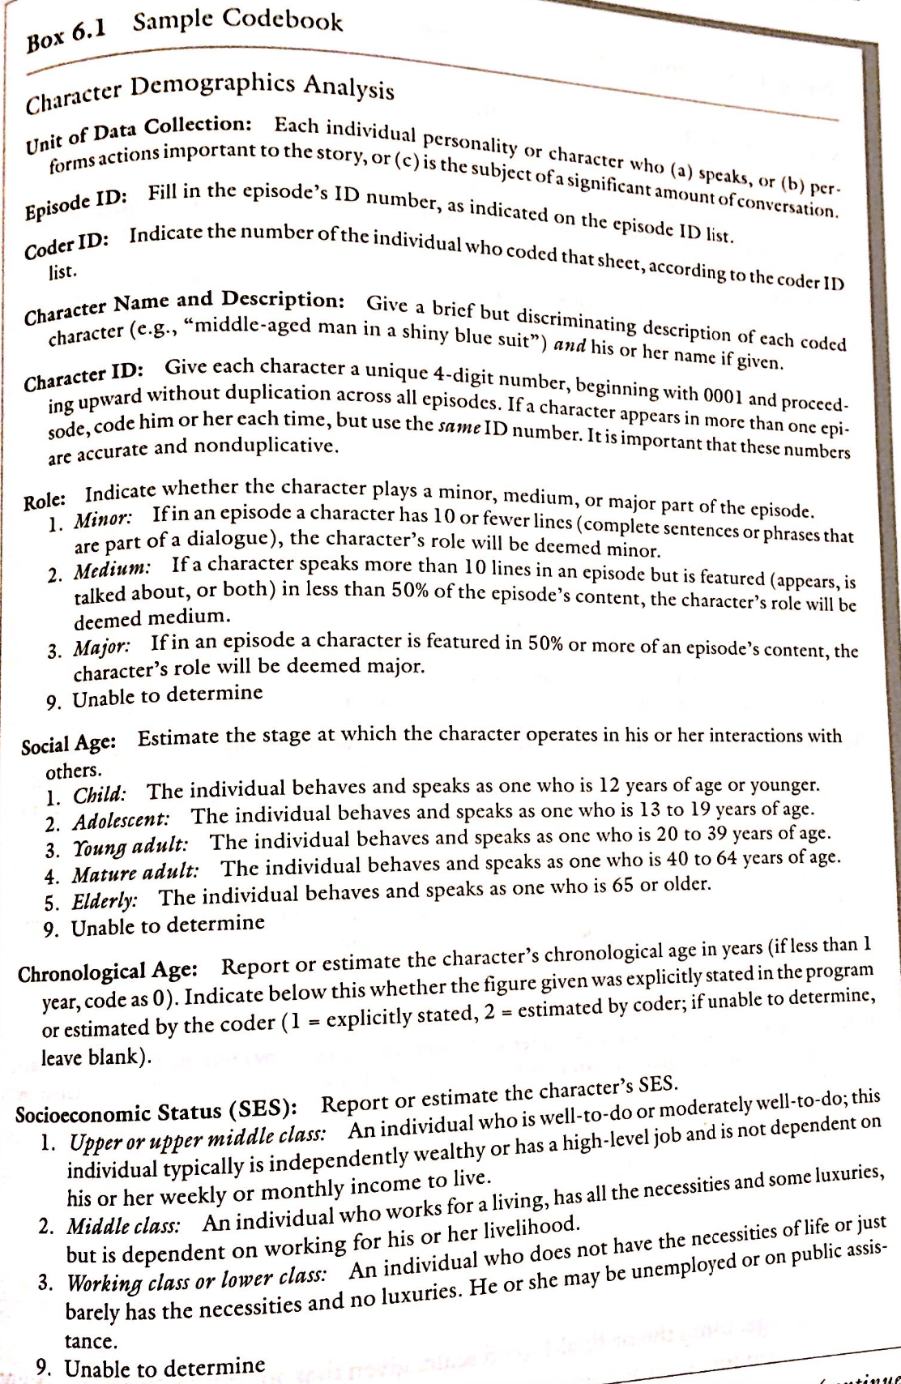

Slide 28
Each variable measures a single thing
Define variables, define unit of collection
Message as a unit of analysis,
a unit of data collection or BOTH
Manifest (face value) v. latent content (underlying)
Presumed cause = independent variable
Presumed effect = dependent variable
Notes:
Each Variable has to measure a single thing
Neuendorf - p 13. message as a unit of analysis, unit of data collection or BOTH
p 23. Manifest v latent content
also p 146
p 48 presumed cause = independent variable
presumed effect = dependent variable
--define variables.
--define unit of collection

Slide 29
Your Turn
Examine this content.
RQ: Dominant themes in lynching news coverage
Unit of analysis?
Categories?

Slide 30
For Tuesday, Oct. 1

Slide 31
Key Concepts
Validity
Reliability - objective measures
Coding Frames
Notes:
recap from last week

Slide 32
Conceptualizations
Determine the variables you want to study
Define the variables with specificity
Violence: "Physical or verbal acts causing harm, including aggression, threats, and harmful language." (Example: Analyzing the portrayal of violence in video games)
Gender Representation: "How men and women are depicted in media, including their roles, stereotypes, and power dynamics." (Example: Examining gender representation in children's books)

Slide 33


Data Analysis and Interpretation: Unveiling the Story
Quantitative analysis: Frequency counts, descriptive statistics, correlations.
Qualitative analysis: Thematic analysis, discourse analysis, content categorization.

Slide 34


Sampling
YOU MAY NEED TO STUDY A REPRESENTATIVE SLICE OF THE MATERIAL.
RANDOM SAMPLE OF THE CONTENT?
TIME PERIOD, BY ISSUE, BY PAGE, BY CHANNEL, ETC

Slide 35
Kimberly Neuendorf,
Cleveland State University
Channeling
Kimberly
Notes:
https://facultyprofile.csuohio.edu/csufacultyprofile/detail.cfm?FacultyID=K_NEUENDORF

Slide 36
Sampling of Your Data
Human Coding:
Training and pilot reliability
Computer Coding:
Apply dictionaries to sample text. Spot check for validation
Human Coding:
Two coders, establish intercoder reliability
Tabulation and Reporting: Trends over time. One variable at a time (univariate) or multiple cross-tabulated (multivariate)

Slide 37
Sampling
How will you randomly sample a subset of the content? This could be by time period, by issue, by page, by channel, and so forth.
Newsweek: One issue per month, random week selected

Slide 38
Human Coding:
Training and Pilot Reliability
During a training session in which coders work together, find out whether they can agree on the coding of variables.
Determine coding reliability.
At each stage, revise the codebook or coding form as needed.

Slide 39
Human Coding
Use at least two coders to establish intercoder reliability. Coding should be done independently, with at least 10% overlap for the reliability test.

Slide 40
Computer Coding
Apply dictionaries to the sample text to generate per-unit (e.g., per-news-story) frequencies for each dictionary. Do some spot checking for validation.

Slide 41
Tabulation and Reporting
Statistics may be reported one variable at a time (univariate)
Or variables cross-tabulated (bivariate and multivariate techniques).
Trends over time

Slide 42
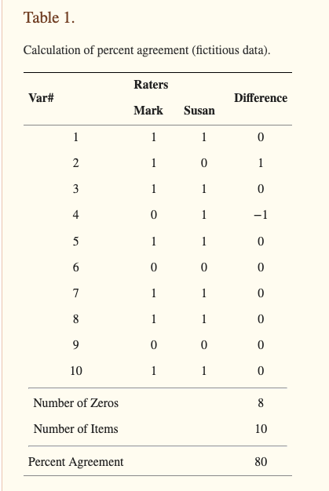
Notes:
McHugh, M. L. (2012). Interrater reliability: The kappa statistic. Biochemia Medica.

Slide 43
Cohen’s kappa
–A type of correlation coefficient
–Jacob Cohen: Percent agreement calculation misses “chance agreement” between coders.
–Cohen’s kappa accounts for the possibility that raters actually guess on at least some variables due to uncertainty.
Notes:
McHugh, M. L. (2012). Interrater reliability: The kappa statistic. Biochemia Medica. https://www.ncbi.nlm.nih.gov/pmc/articles/PMC3900052/?report=printable

Slide 44
Cohen’s kappa
–Can range from −1 to +1
–0 = agreement expected from random chance
–1 = perfect agreement between the coders
Notes:
McHugh, M. L. (2012). Interrater reliability: The kappa statistic. Biochemia Medica. https://www.ncbi.nlm.nih.gov/pmc/articles/PMC3900052/?report=printable

Slide 45
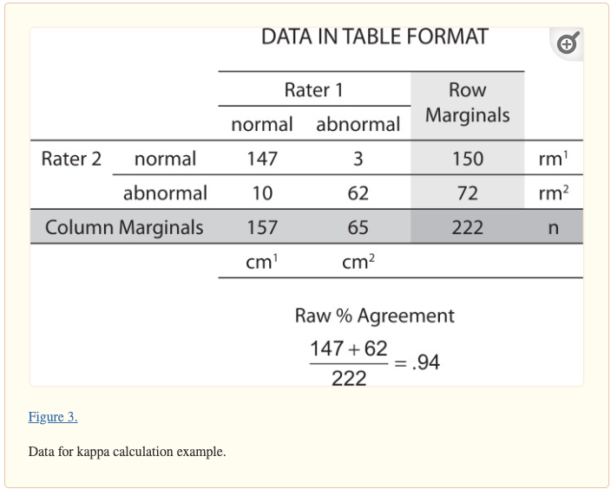
Notes:
McHugh, M. L. (2012). Interrater reliability: The kappa statistic. Biochemia Medica.

Slide 46
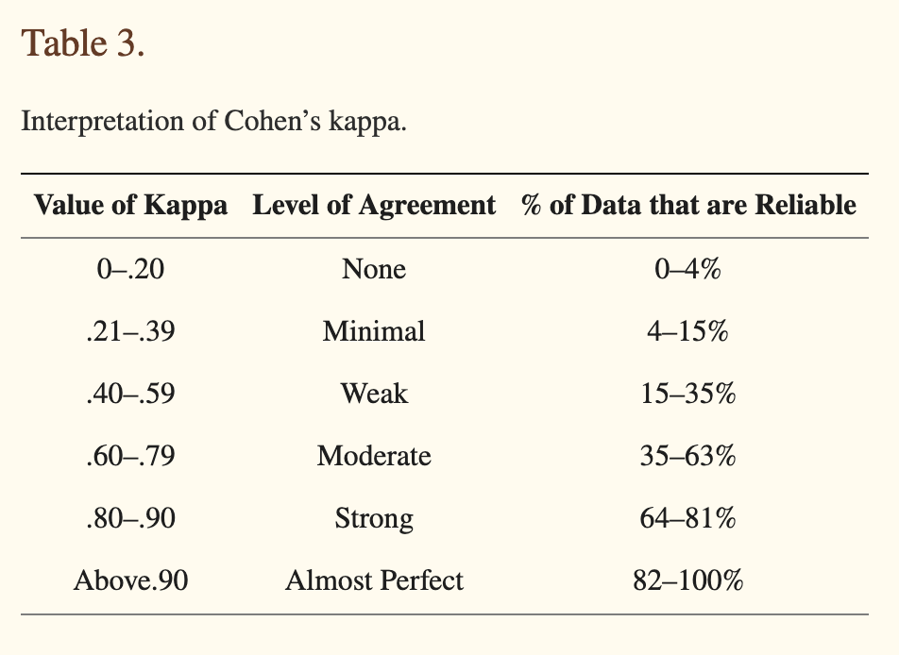
Notes:
McHugh, M. L. (2012). Interrater reliability: The kappa statistic. Biochemia Medica.

Slide 47
Tabulation and Reporting
Figures and statistics may be reported one variable at a time (univariate)
Variables may be cross-tabulated in different ways (bivariate and multivariate techniques).
Over-time trends are also a common reporting method

Slide 48
Challenges/Problems
Berger: Problem with content analysis is interpretation of the data it yields.

Slide 49
The Recap

Slide 50



Coding Training and Reliability
CODERS WORK TOGETHER, FIND OUT WHETHER THEY CAN AGREE ON THE CODING OF VARIABLES.
CONDUCT INDEPENDENT CODING TEST, DETERMINE RELIABILITY ON EACH VARIABLE.
REVISE THE CODEBOOK OR CODING FORM AS NEEDED.

Slide 51
Coding
Use
Apply
Spot
Use at least two coders, working independently, to establish intercoder reliability.
Apply codes to sample text to generate per-unit (e.g., per-news-story) frequencies for each dictionary.
Spot checking for validation.

Slide 52


Final Reliability
Calculate a reliability figure (percent agreement) for each variable.
Scott's pi, Spearman's rho, or Pearson's r
Notes:
Cohen's kappa - measure interrater reliability
kappa of 0.8 or 0.9 is desired. 0.7 is minimum.

Slide 53
For Tuesday, Oct 8

Slide 54
Readings
Lasswell, Harold, (1948).
“The Structure and Function of Communication in Society.”
Communication of Ideas, 37–51.

Slide 55
HERE COMES THE BIG WHITE MAN

Slide 56
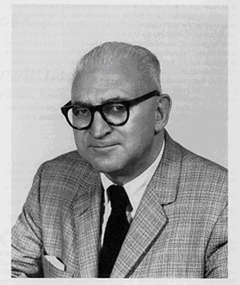
The structure and function of communication in society

Slide 57
Harold D. Lasswell, 1902-1978 Founding Father of Communications Studies
"Content analysis is a teaching which aims at describing, with optimal objectivity, precision and generality, which is said on a given subject on a given place at a given time."
The structure and function of communication in society

Slide 58




Steps in Communications Studies
Who: Control analysis. Factors that drive communication
Says what: Content analysis
In what channel: Media analysis
To whom: Audience analysis, people consuming media
With what effect: Effect analysis

Slide 59
Positivism:
The communication processes of human society, when examined in detail, reveal many equivalences to the specializations found in the physical organism and in the lower animal societies (219)
See p 223: "The processes here sketched run parallel to phenomena to be observed throughout the animal kingdom."

Slide 60
“Pioneering theoretical model of media effects”
Lasswell’s research revolved around propaganda and its impact. World War I — advertising and PR industries ability to “engineer consent"
His early work important because it described how, why and what conditions propagandists could be successful
Lasswell’s theories reflect transmission, classic media effects: Senders and receivers (218) or each relay point in the chain

Slide 61
Who Says What In Which Channel
To Whom With What Effect?

Slide 62
Lasswell- Three Roles of Media
—Surveillance: provide information for individuals and society at large
—Correlation: media explain and interpret events - connect different elements of society (democratic function)
—Transmission: media as agent of socialization, disseminate cultural heritage to next generation

Slide 63
Structure and function
Communication is studied as a whole of the acts of communication, relating each to the entire social process

Slide 64
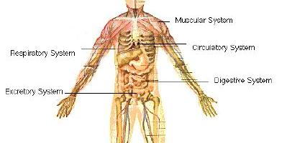
Biological equivalences
Notes:
Lasswell mentions animals and their internal communication and the way it affects external communication with stimuli, etc and vice versa. Each member of animal society has a role to play both with itself and its community. With this metaphor, communication involves both the individual and the way said individual communicates and responds to the environment

